Slide 1
IC
The Calculation Pad
Doing sums in InnoCalc - the easy way
InnoCalc v0.0.1 | Innovis training
Notes:
This session shows how to write a calculation in the Calculation Pad, from opening it to saving it and finding it again. No coding is needed. Bring a laptop with InnoCalc running if you want to follow along; the practice exercise is on the second-last slide.

Slide 2
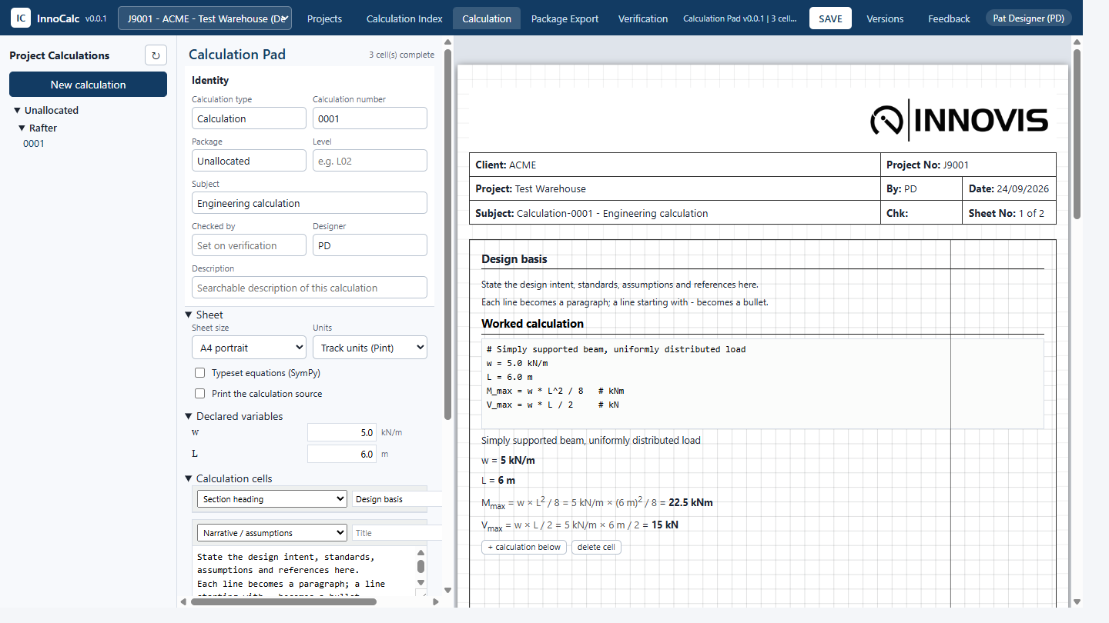
IC
What is the Calculation Pad?
• It is clever grid paper.
• You write a sum. It does the maths.
• It prints on the same Innovis sheet as every other calculation.
• It remembers every version you save.
InnoCalc v0.0.1 | Calculation Pad training | 2
Notes:
Think of the pad as squared paper that can do arithmetic. You write the working the way you would by hand, and the pad writes it out neatly with the numbers put in and the answer at the end.

Slide 3
IC
When do I use it?
• Load takedowns
• Design philosophy and assumptions
• Quick checks and assessments
• Sketches and marked-up drawings
• Not when there is already a module for it (Steel Member, Concrete Column)
InnoCalc v0.0.1 | Calculation Pad training | 3
Notes:
If a proper module exists, use it: it has been tested and validated for that job. The pad is for everything else.

Slide 4
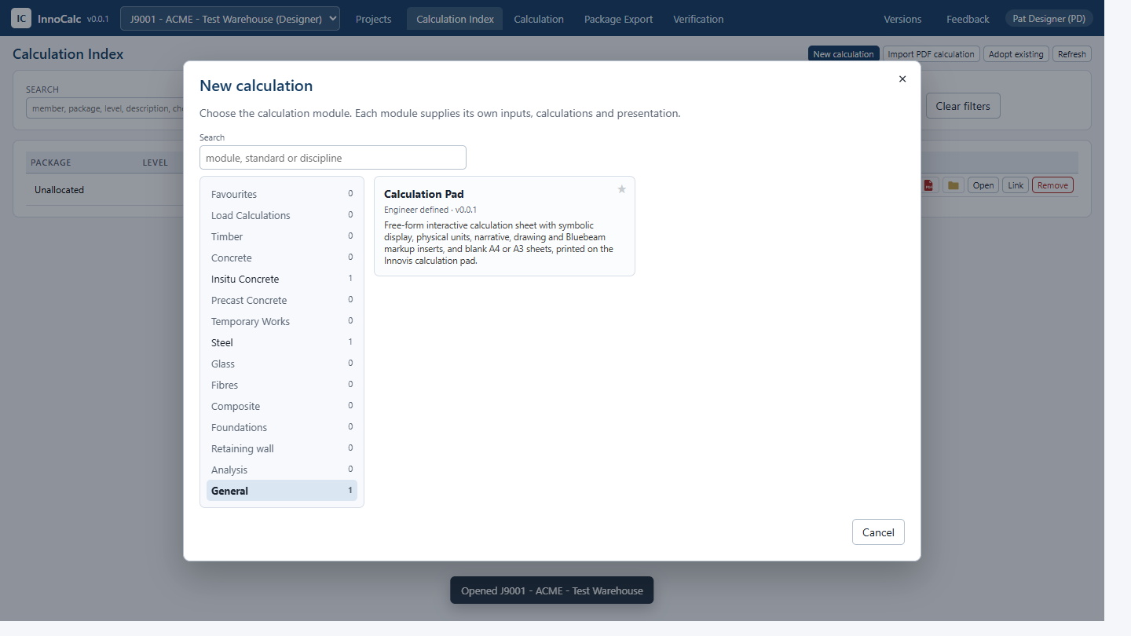
IC
Open the pad
• Open your project (Projects button).
• Press New calculation.
• Choose General on the left.
• Click Calculation Pad.
InnoCalc v0.0.1 | Calculation Pad training | 4
Notes:
Press the star on the card to keep the Calculation Pad in Favourites.

Slide 5
IC
The three parts of the screen
• Left: every calculation in the project.
• Middle: the boxes - who, what, and the list of cells.
• Right: the printed sheet. It changes as you type.
InnoCalc v0.0.1 | Calculation Pad training | 5
Notes:
Most of your time is spent on the right, typing into the sheet itself.

Slide 6
IC
Say what it is
• Calculation type and number - e.g. Lintel 0003
• Package - which group of calculations it belongs to
• Level - e.g. L02
• Subject - one line that describes it
• Description - words people will search for
InnoCalc v0.0.1 | Calculation Pad training | 6
Notes:
These fill the sheet header and file the calculation in the right folder. The Checked by box fills itself when a verifier signs the package off.

Slide 7
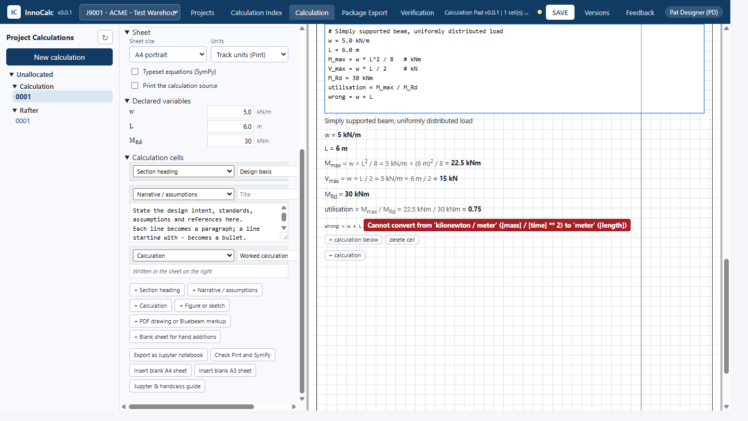
IC
Cells are like building blocks
• Section heading
• Narrative / assumptions (a line starting with - is a bullet)
• Calculation
• Figure or sketch
• PDF drawing or Bluebeam markup
• Blank A4 or A3 sheet for hand additions
InnoCalc v0.0.1 | Calculation Pad training | 7
Notes:
Add blocks with the + buttons in the middle panel. Use the arrows to move them up and down and x to delete one.

Slide 8
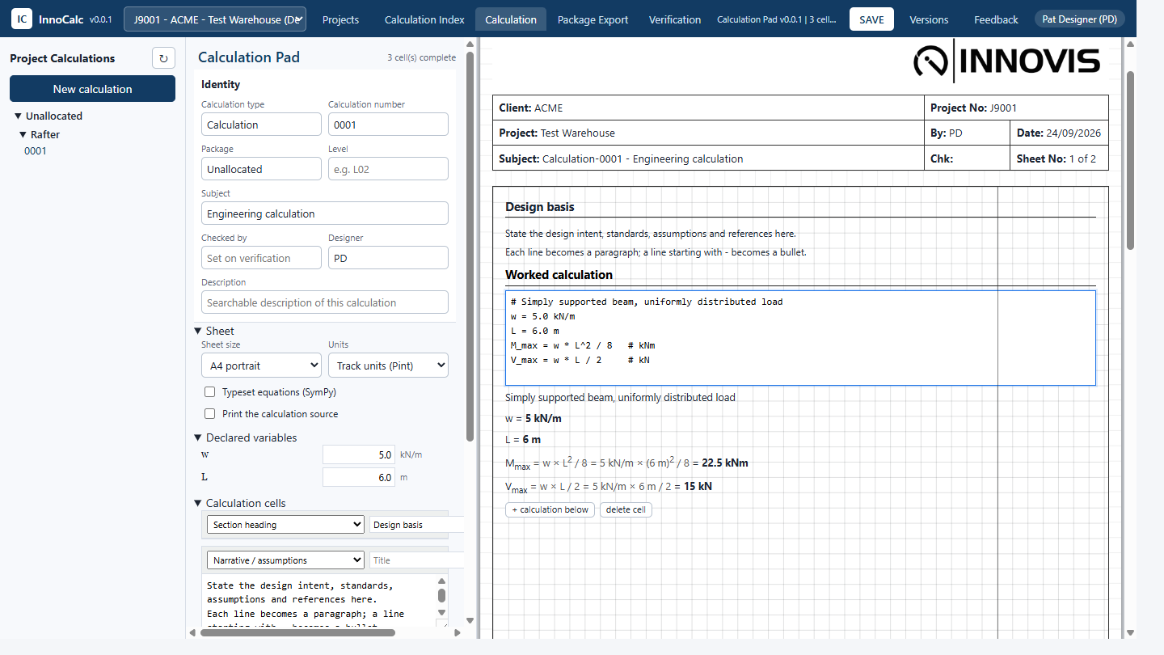
IC
Write a sum - in the sheet
• Click the grey box on the sheet.
• Type one sum per line:
  w = 5.0 kN/m
  L = 6.0 m
  M_max = w * L^2 / 8 # kNm
• The answer appears underneath straight away.
InnoCalc v0.0.1 | Calculation Pad training | 8
Notes:
Each line becomes a printed line: the formula, the numbers put in, then the answer in bold. Later lines can use anything worked out above them.

Slide 9
IC
How to write it
• A few little rules:
  L^2 power (or L**2)
  M_x_max subscript: M with x,max below
  phi, alpha Greek letters by name
  # a note a whole comment line prints as a note
  sqrt min max sin cos log pi ...
• Make up clear names - they are printed.
InnoCalc v0.0.1 | Calculation Pad training | 9
Notes:
The notation matches handcalcs, so it is the same as the Jupyter tools if you ever outgrow the pad.

Slide 10
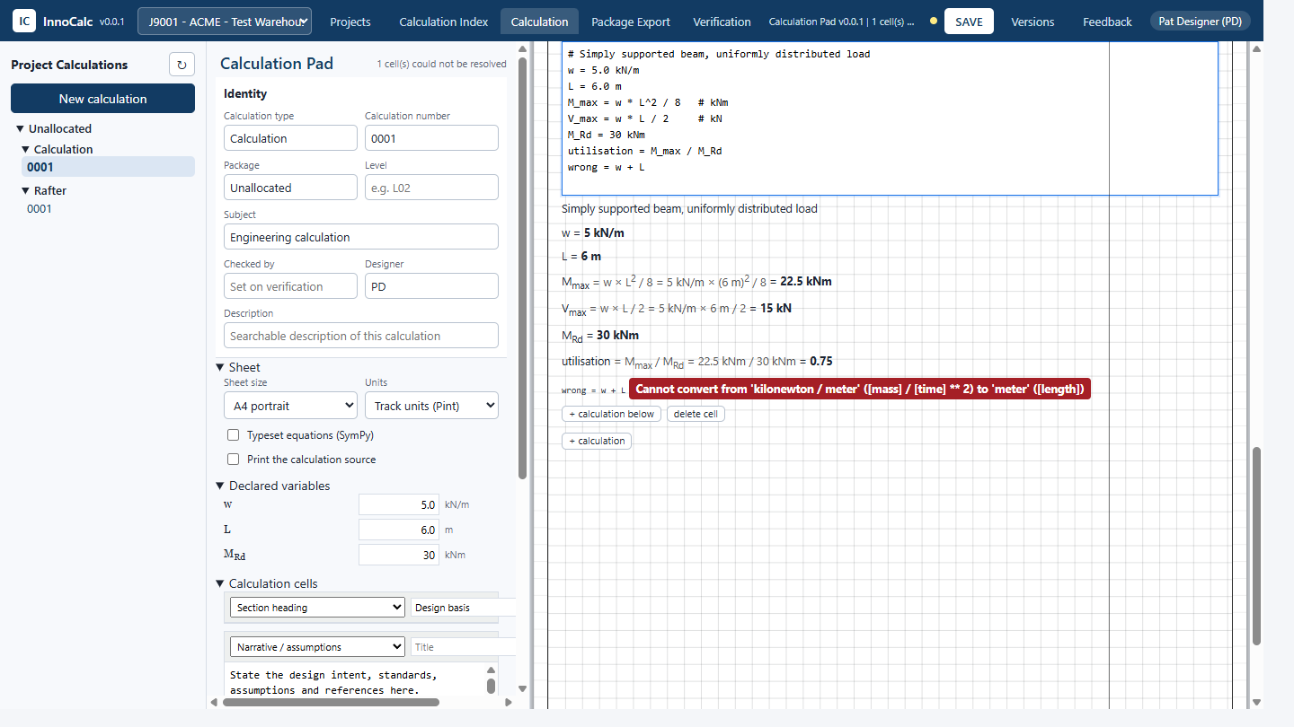
IC
Numbers wear their units
• Write the unit straight after the number:
  b = 250 mm
  Z = b * d^2 / 6 # mm**3
• The # unit at the end converts the answer.
• Add a force to a length and it goes red - that saves you from mistakes.
InnoCalc v0.0.1 | Calculation Pad training | 10
Notes:
Units are real. 5 kN/m times 6 m squared divided by 8 really is 22.5 kNm. If the units cannot balance, the line says so instead of printing a wrong number. Set Units to Plain numbers if you only want labels.

Slide 11
IC
Declared values - your inputs
• A line that is just a number is an input: w = 5 kN/m
• Inputs are listed in Declared variables in the middle panel.
• Change one there and every sum below updates.
• Nothing else moves on the sheet.
InnoCalc v0.0.1 | Calculation Pad training | 11
Notes:
This is how you try a different span or load quickly without hunting through the sheet.

Slide 12
IC
Tell InnoCalc how hard it is working
• Name a line utilisation (or util):
  M_Rd = 30 kNm
  utilisation = M_max / M_Rd
• InnoCalc shows it in the Calculation Index and the package contents.
• Over 1.0 is shown in red.
InnoCalc v0.0.1 | Calculation Pad training | 12
Notes:
Without a utilisation line the pad is filed without one, which is fine for narrative-only sheets.

Slide 13
IC
Algebra when you need it
• Make a symbol, then let SymPy do the algebra:
  x = sym("x")
  roots = solve(x^2 - 3*x - 10, x)
• Also: simplify, expand, factor, diff, integrate, limit
• Tick Typeset equations for real fractions and roots on the sheet.
InnoCalc v0.0.1 | Calculation Pad training | 13
Notes:
SymPy does the algebra. The substitution line underneath still shows units.

Slide 14
IC
Drawings and markups
• Add a PDF drawing or Bluebeam markup cell.
• Give the file and the pages (1, 1,3-5, or blank for all).
• On screen it is a placeholder.
• In a package the real pages are put in at that spot.
• Insert blank A4 / A3 sheets for hand sketches.
InnoCalc v0.0.1 | Calculation Pad training | 14
Notes:
This is how a sketch or a marked-up drawing travels inside the calculation set, in the right place.

Slide 15
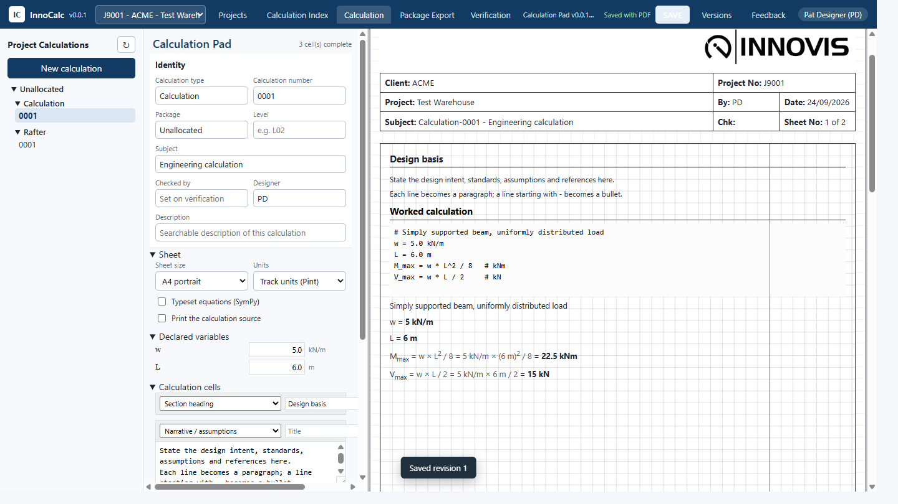
IC
Save
• Press SAVE (or Ctrl + S).
• Yellow dot = changes not saved yet.
• Each save is a new revision; the old one is kept as superseded.
• The PDF is printed for you.
InnoCalc v0.0.1 | Calculation Pad training | 15
Notes:
If you try to leave with unsaved changes InnoCalc asks whether to save them.

Slide 16
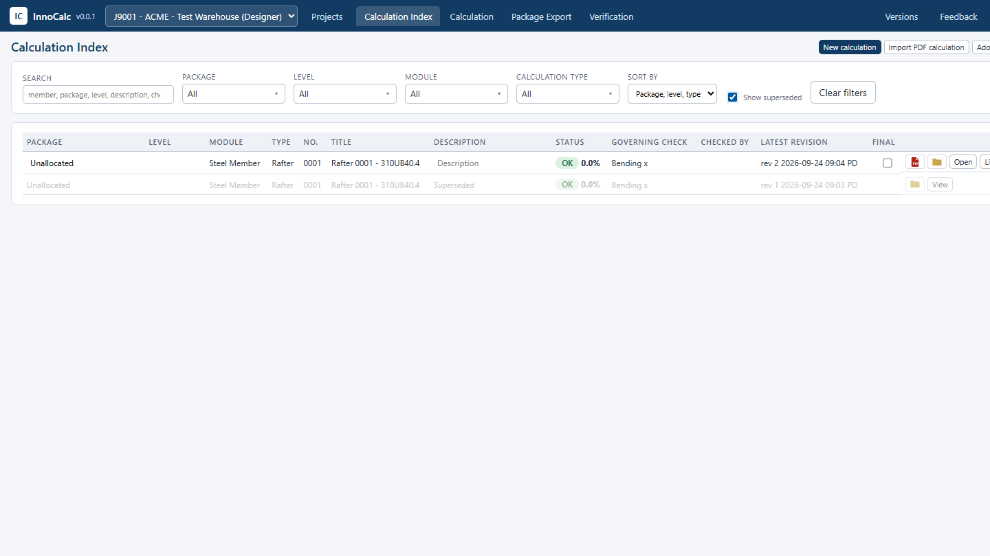
IC
Find it again
• Calculation Index lists everything in the project.
• Search, or filter by package, level, module and type.
• Tick Show superseded to see older revisions in grey.
• Open brings it back to the pad.
InnoCalc v0.0.1 | Calculation Pad training | 16
Notes:
The PDF symbol opens the printed sheet; the folder symbol opens its folder.

Slide 17
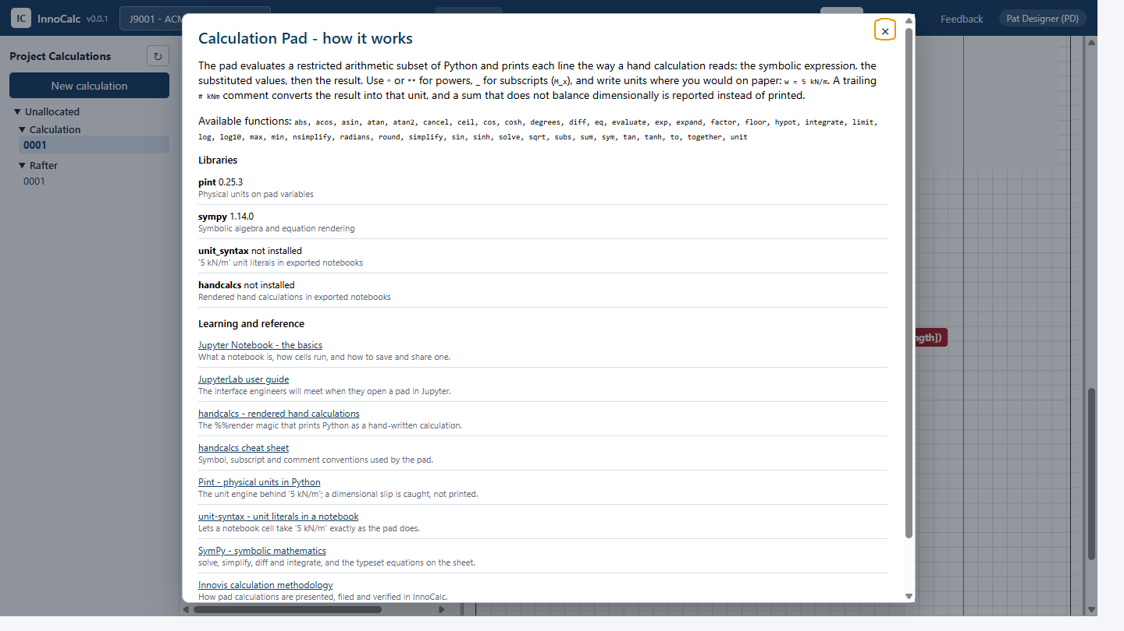
IC
Too big for the pad?
• Export as Jupyter notebook - every sum becomes a handcalcs cell.
• Check Pint and SymPy - see which libraries are installed.
• Jupyter & handcalcs guide - links to training.
InnoCalc v0.0.1 | Calculation Pad training | 17
Notes:
Use a notebook when a pad needs loops, tables or charts. If the same notebook is used again and again, it should become a proper module: see README-USER-CALCDEVELOPMENT.md.

Slide 18
IC
Why it will not run 'real' code
• Pads live on the shared drive and other people open them.
• So a pad can only do arithmetic and the listed functions.
• No imports, no files, no internet.
• A pad can never harm someone else's computer.
InnoCalc v0.0.1 | Calculation Pad training | 18
Notes:
Every line is checked before it is worked out. Anything not allowed gets a message on the sheet instead.

Slide 19
IC
Golden rules
• One sum per line, clear names.
• Always write the units.
• Add a utilisation line for design checks.
• Write the assumptions in a narrative cell.
• Save often - watch the yellow dot.
• A pad is still checked like any hand calculation.
InnoCalc v0.0.1 | Calculation Pad training | 19
Notes:
The pad makes arithmetic reliable. It does not make the engineering right: the method, loads and assumptions are still yours to check.

Slide 20
IC
Try it: a simple beam
• New Calculation Pad, type Beam 0001.
• Write:
  w = 5.0 kN/m
  L = 6.0 m
  M_max = w * L^2 / 8 # kNm
  M_Rd = 30 kNm
  utilisation = M_max / M_Rd
• Change L to 8 m in Declared variables. What happens? Save it.
InnoCalc v0.0.1 | Calculation Pad training | 20
Notes:
Answer: M_max goes from 22.5 to 40 kNm and utilisation from 0.75 to 1.33, shown in red. Put L back to 6 m, save, then find the calculation in the Calculation Index.

Slide 21
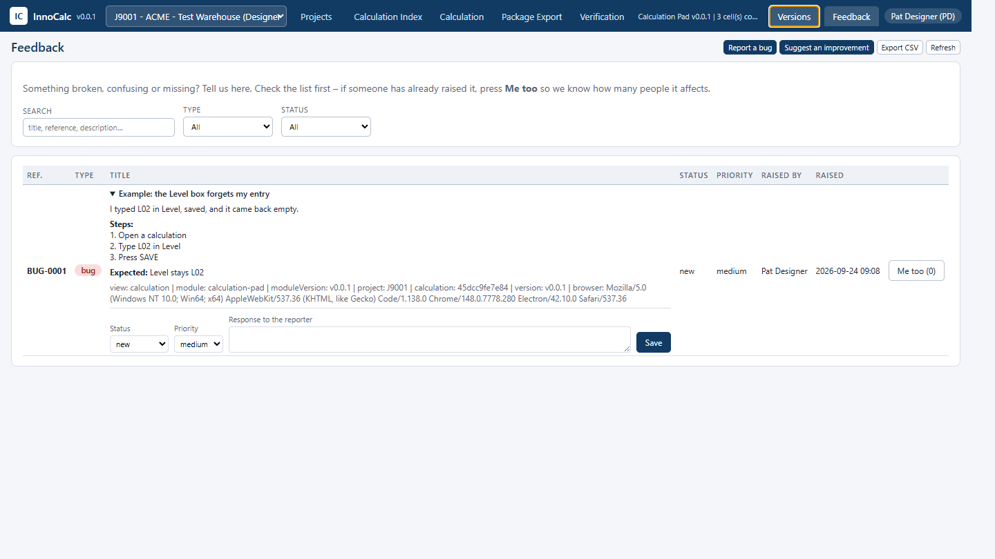
IC
Help and feedback
• Press Feedback in the top bar.
• Report a bug - say what you pressed and what went wrong.
• Suggest an improvement - tell us what would help.
• See something already listed? Press Me too.
• User guide: README-ENDUSER.md
InnoCalc v0.0.1 | Calculation Pad training | 21
Notes:
InnoCalc adds the page, module and version to your report automatically.

